Slide 1
Building Dashboards

Slide 2
We’ll cover
A crash-course in front-end dev:
Basics of JavaScript
Flask Apps
Data Serialization
Basics of API calls

Slide 3
Helpful Resources
Dash Documentation
https://dash.plot.ly/
https://dash.plot.ly/dash-core-components
Flask Documentation
http://flask.pocoo.org/docs/1.0/
Javascript intro
https://www.w3schools.com/js/

Slide 4
Let’s create an App!
Install npm, the package manager:
Linux: apt-get install npm
Mac: brew install node
Windows: install linux! j/k. http://blog.teamtreehouse.com/install-node-js-npm-windows
I haven’t tested the windows instructions!
Pull the git repo into your working directory (move there first!)
git clone git@github.com:akelleh/website ./website
Browse to the website/ directory app

Slide 5
What did we just do?!
Installed npm, a package manager for javascript
Pulled the code located at github.com/akelleh/website, and stored it in ./website
Moved to a directory containing a basic website

Slide 6
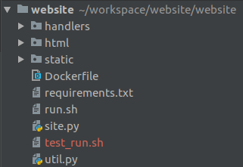
Let’s take a look inside...
handlers: server endpoints
html: The main html file for the app
static: stylesheets, js, and images
node_modules: installed js libraries (none here!)

Slide 7
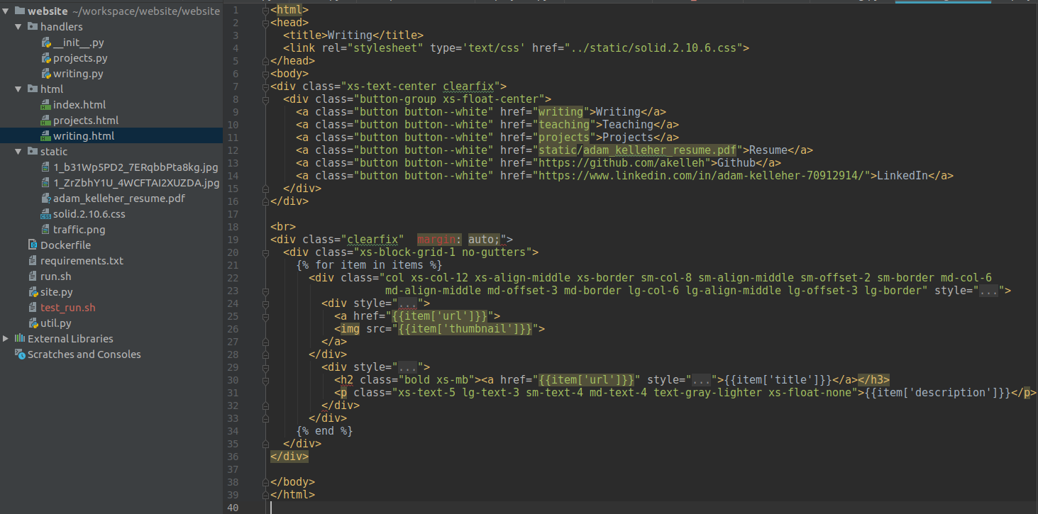
Formatting comes from the CSS

Slide 8
The body doesn’t actually contain data!

Slide 9
This is python code doing the work!

Slide 10
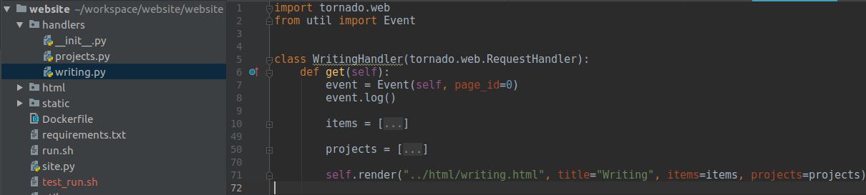
Where does the Python get executed?
In the RequestHandler!

Slide 11
Basic Data Structures:
tornado.web.Application
Define routes to different endpoints, and enumerate the handlers for each
Parse parameters to pass on to request handlers
tornado.web.RequestHandler
Define methods to handle http verbs
Process the request, and provide a response

Slide 12
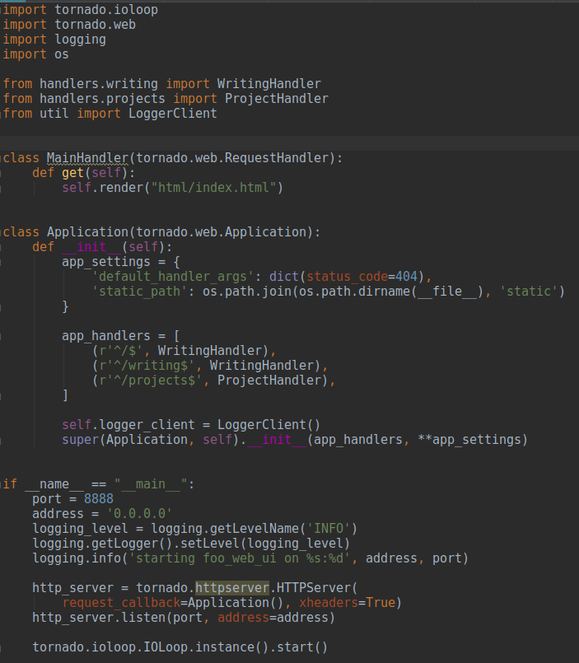
Very simple request handler for the main page (not actually used here!)
Application definition. Add request handlers here.
The request handlers!
Wait for and handle requests in an infinite loop.

Slide 13
How does it work?
Just run the IOLoop! You can do this on your local machine:
python3 site.py
Then navigate to http://localhost:8888 to see the site!
This will be your debug cycle:
Change code -> run server -> refresh page -> repeat
(Demo)

Slide 14
How does it work?
What happens?
Your browser sends a GET request to the server
The server checks the RequestHandler for the URL you’ve requested
It runs the get method of that RequestHandler, and returns the result

Slide 15
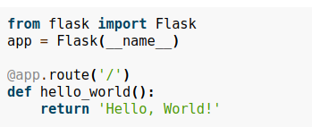
Flask
Some packages greatly simplify this, while making it more complicated at the same time!
The app is similar to Tornado’s
The decorator is like registering a request handler to the app
The function is executed for a GET request
(Demo)

Slide 16
Dash
Dash makes this all even simpler (and more abstract)
The Layout object is a tree of dash html components.
You can add dash core components to build plots.

Slide 17
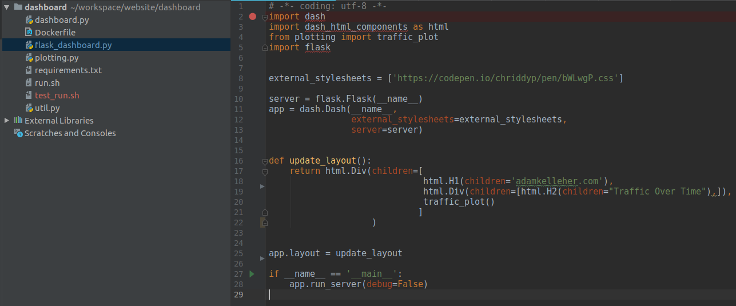

Slide 18
The app is now a Dash app
Pages are normally rendered at run-time, and not dynamically! This extra function makes the page re-render on page refresh

Slide 19
We can play with the html to add/remove elements from the page.
(demo)

Slide 20
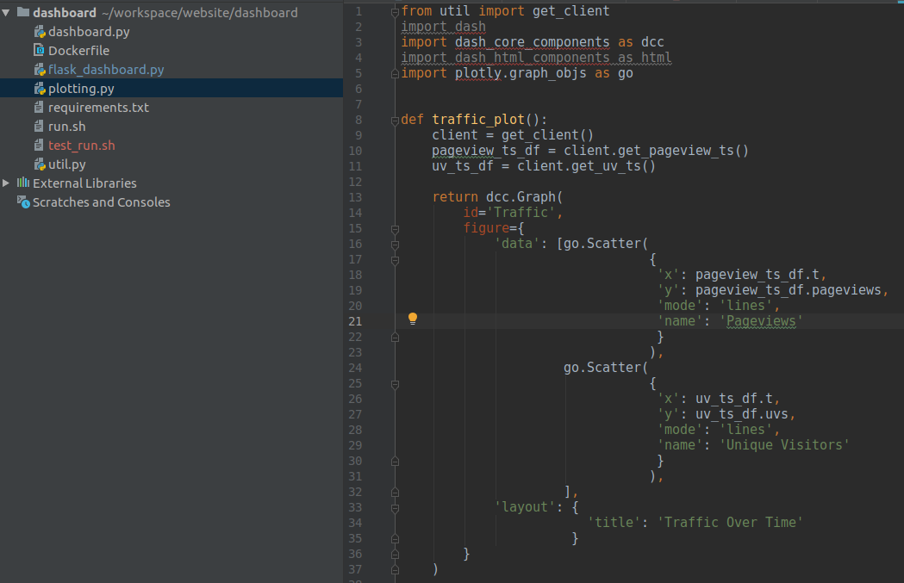
How does the plot work?

Slide 21
How does the plot work?
Utilities get data as a pandas dataframe

Slide 22
How does the plot work?
We create the graph as a graph object by passing in data.
When we run the traffic_plot() function, we automatically get fresh data from the database. It populates the graph, and the page loads!

Slide 23
Flask is great, but ...
It’s not built for multiple users. You need a better server for that
Fortunately, there’s a hack to wrap it into Tornado!

Slide 24
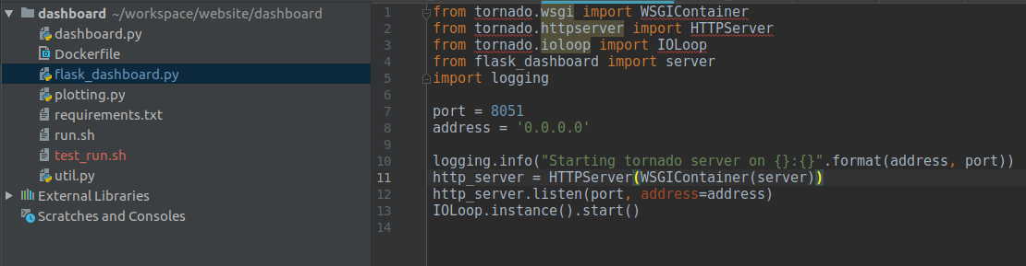

Slide 25
We can run it all together now...
(demo)

Slide 26
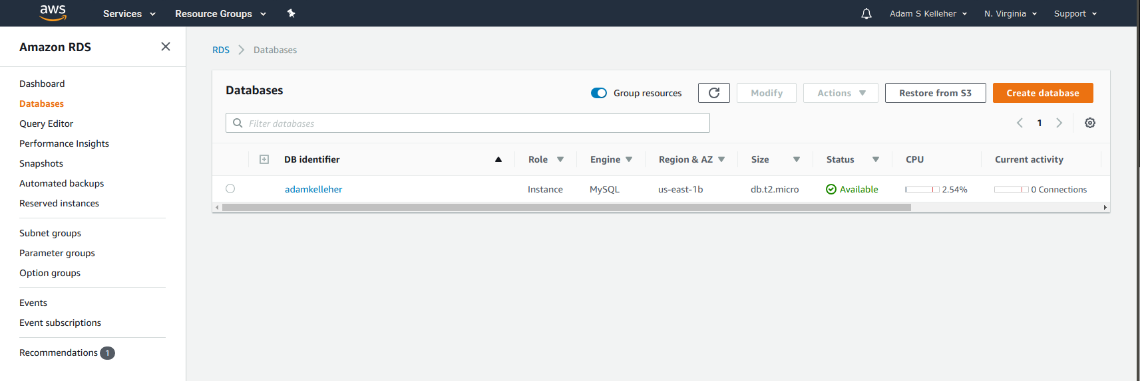
But where did the data come from?

Slide 27
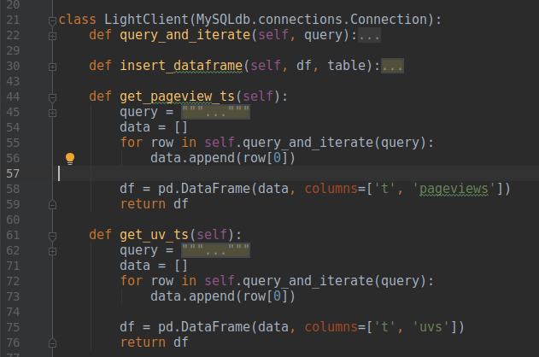
In util.py ...

Slide 28
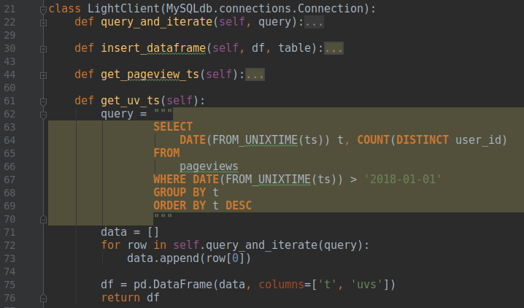
Just plain SQL queries!

Slide 29
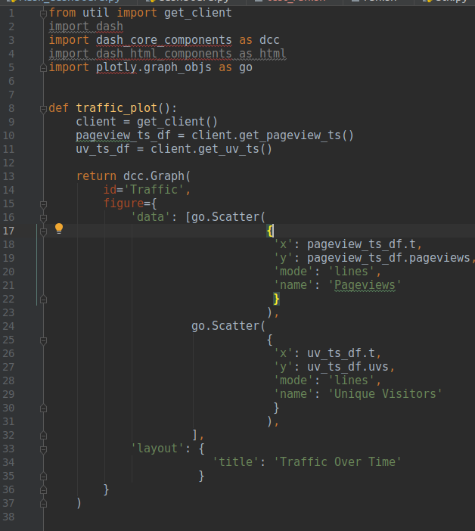
Why not code the
query here?

Slide 30
Adding the abstraction layer ...
Makes it easier to add more queries elsewhere (don’t repeat the connection boilerplate)
Makes it easier to change data sources!

Slide 31
What if ...
I wanted to change the SQL database to Redis?
I have to modify the LightClient to connect to and query from Redis.

Slide 32
What if …
I wanted to change the SQL database to Redis, and I hadn’t used the abstraction?
I have to modify the code to connect to and query from Redis anywhere the connection is hard-coded. Easy here, but with bigger apps it gets hard.
It’s much messier to make the change!!
The abstraction decouples the data source from the application
As long as I expose the same methods, and they return the same format, the application doesn’t care about the data store.

Slide 33
What if ...
There were many applications all wanting to use the same database?
Databases can only handle so many requests at a time.
The client doesn’t work anymore! What is a better pattern?
Next time we’ll learn about APIs and how they can help.

Slide 34
For now, let’s see where the data comes from...
Check out website/event_logger/

Slide 35
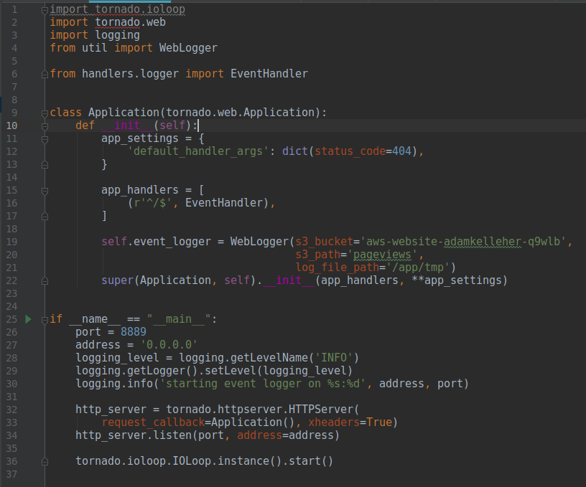
More
Tornado!

Slide 36
S3
Website
event_logger
MySQL
db_import_service
Disk

Slide 37
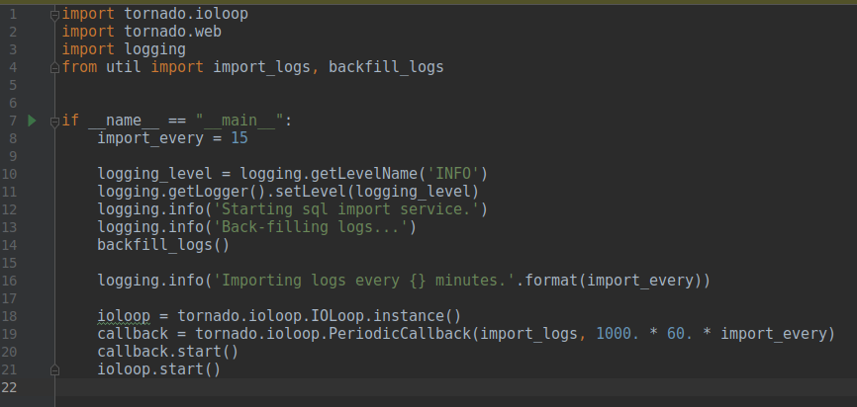
db_import_service

Slide 38
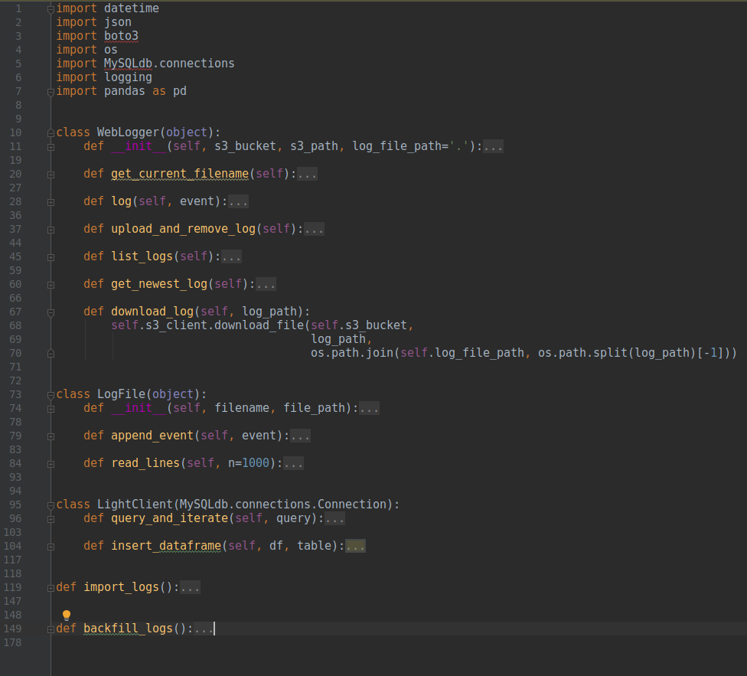
All the work...
Boto3 talks to AWS
MySQLdb manages SQL connections
We abstract on top of these tools to create a LogFile concept, and a WebLogger object.
Each log entry has a unique ID, so backfilling is idempotent

Slide 39
db_import_service

Slide 40
Now for the value proposition!
Dashboards aren’t just cool ways to visualize data -- they’re useful for jobs!
You need to deliver information to people within the business
They all have different levels of interest and motivation!

Slide 41
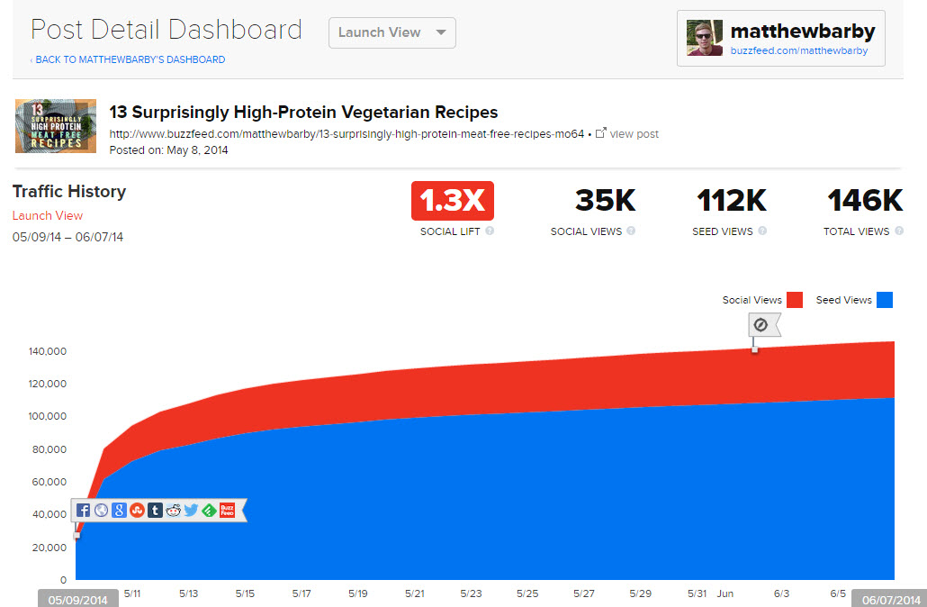

Slide 42
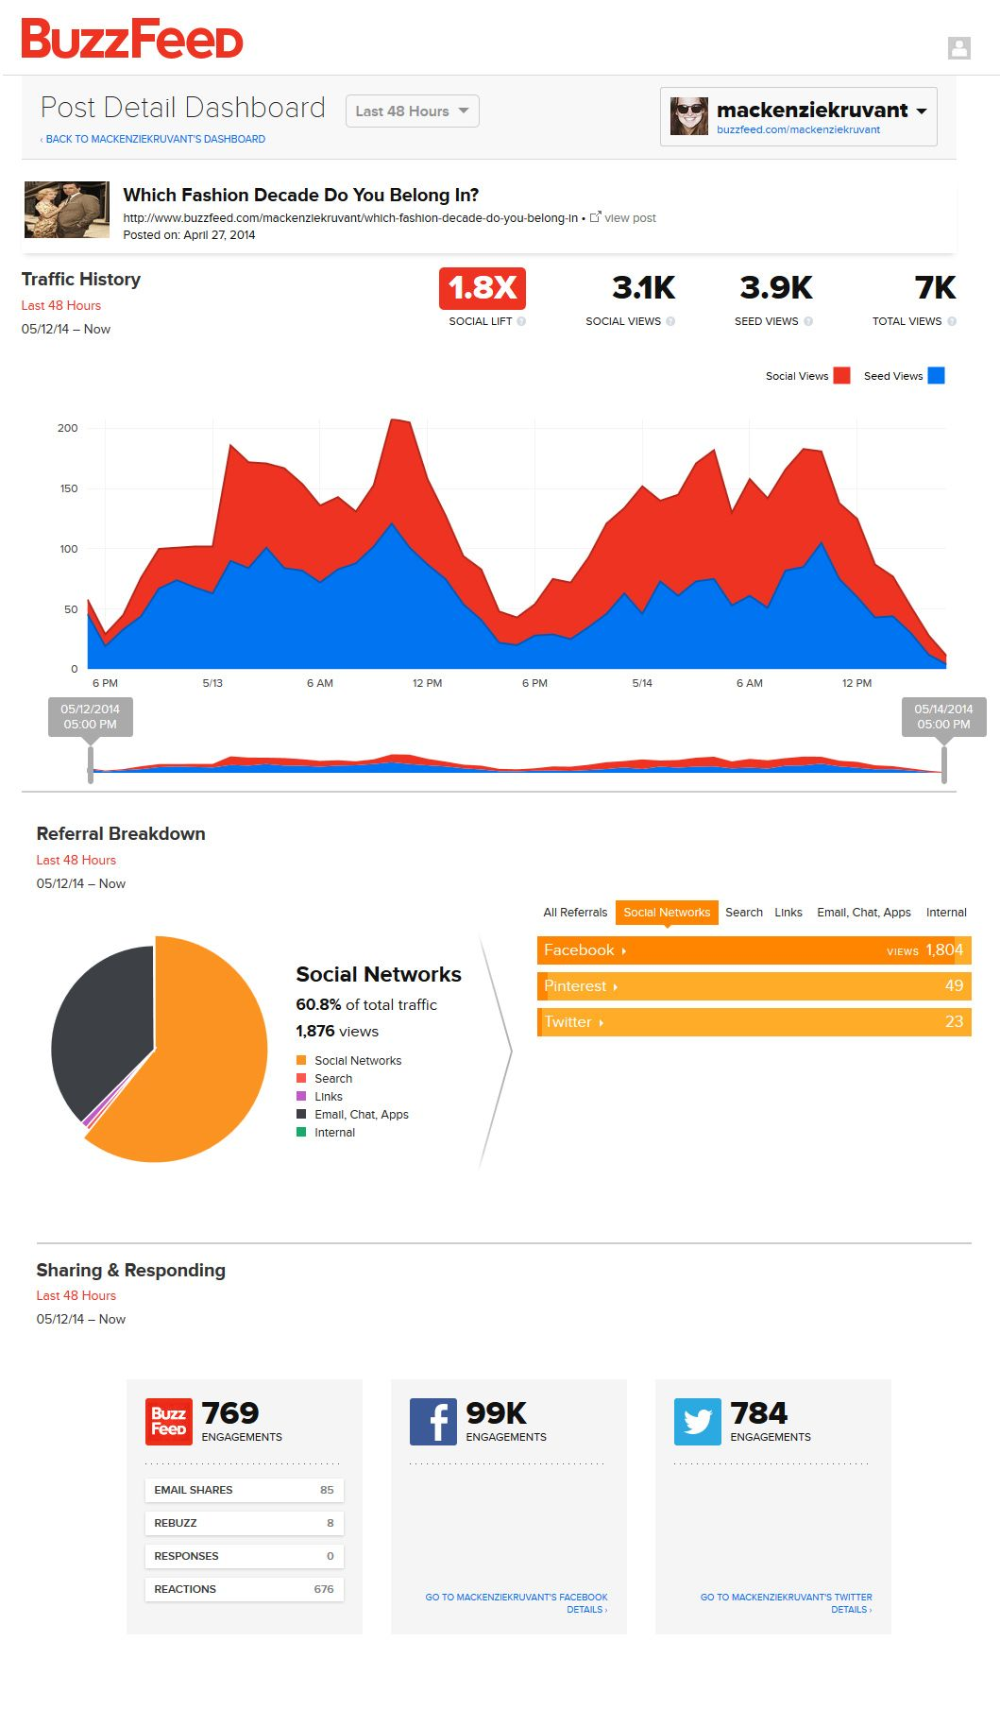

Slide 43
Push vs. Pull
A Push mechanism sends the information to the user.
Push alerts, emails, text messages, chat bots
A Pull mechanism requires action by the user
Websites, dashboards

Slide 44
Push vs. Pull
Pushing content is great when a user is less engaged. It can drive new engagement!
Pushing too much or too often can start to look like spam, and get ignored.
Try keeping the presentation very simple. Less engaged users want an easy experience.
Work with the end users to make sure the presentation is engaging, and the information is useful.
Record statistics to keep track of how well users are engaging.

Slide 45
Push vs. Pull
A pull mechanism can be more sophisticated. Users are more engaged, and might get more out of diving deep into the data
These users are often eager to learn more, and can account for many of the requests for information your team gets.
Consider if you keep getting the same request: could a dashboard answer this question so I don’t have to?

Slide 46
It’s easy to make simple dashboards with Flask/Dash/Tornado
For power users, look at Looker and other Business Intelligence (BI) platforms for building many dashboards at scale.
Consider whether a report should be a dashboard or an email
Chat bots can be extra engaging, if your company has a good Slack (or other) culture.

Slide 47
Intro to Docker
Docker is a tool for turning scripts into the little boxes we draw
Docker helps manage connections between services, and keeps them running as daemons. It’s useful when you need to scale up!
Let’s see how it works!

Slide 48
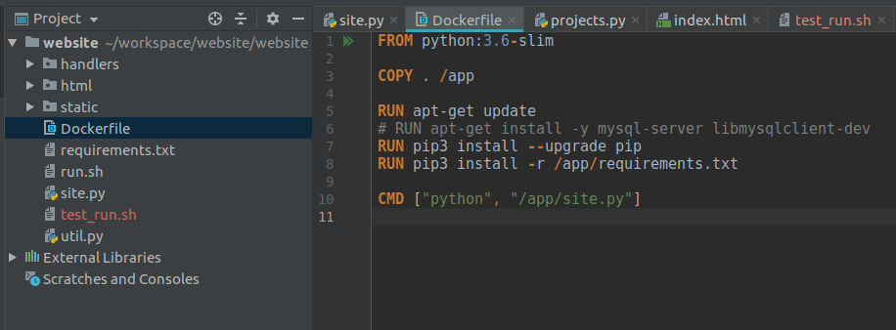
For the website ...

Slide 49
We can imagine starting with a clean virtual environment, and installing everything from scratch.
The Dockerfile makes your system configuration transportable!
You can push a dockerized application to dockerhub just as you push code to github!

Slide 50
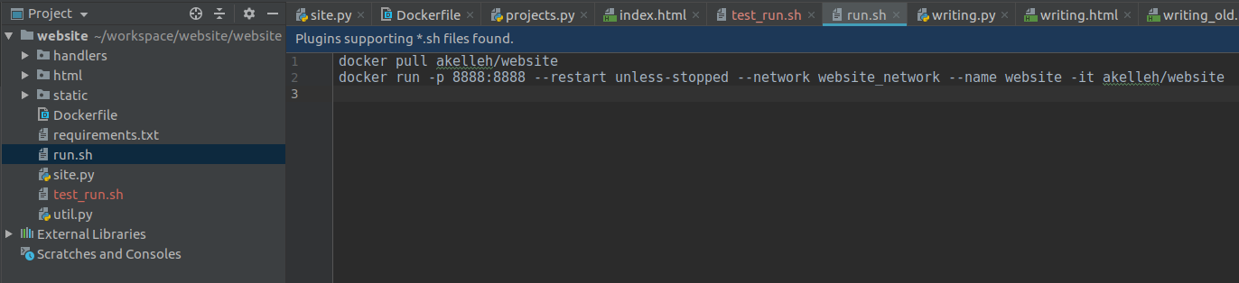
If the app fails, restart it unless we explicitly stop it
Map the docker app’s port 8888 to the host port 8888
Create a network for my apps to connect over called website_network

Slide 51
Call the container website, and tag it as the latest build of the remote akelleh/website

Slide 52
Some handy commands

Slide 53
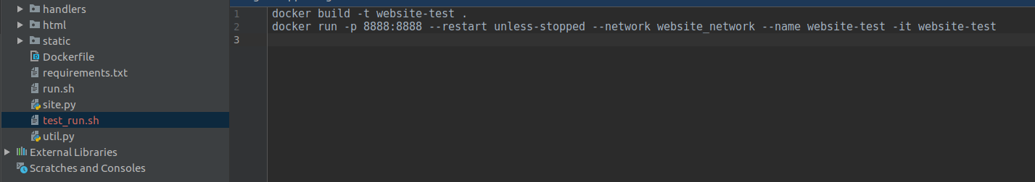
For debugging ...

